Slide 1
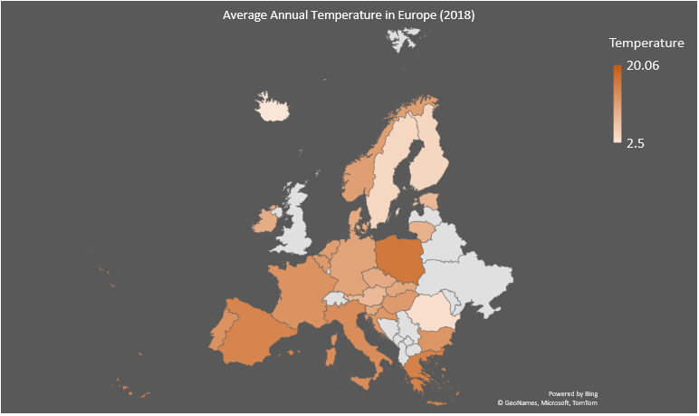
Air Quality
Temperature
Fires
Emissions
2018

Slide 2
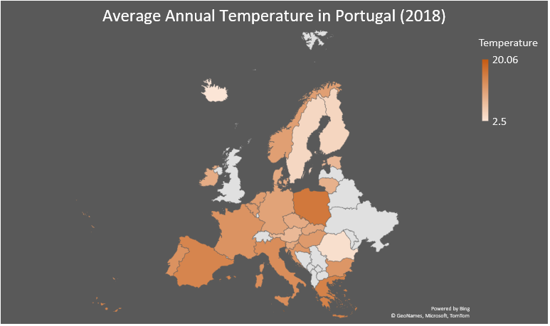
Air Quality
Temperature
Fires
Emissions per Capita
2018

Slide 3
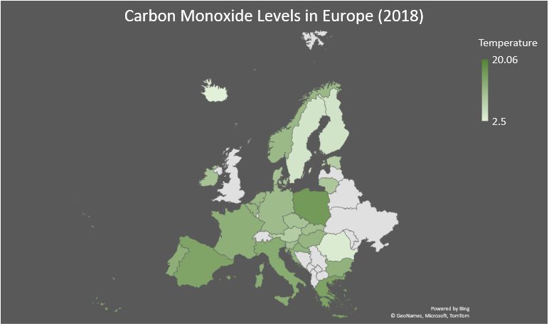
Air Quality
Temperature
Fires
Emissions per Capita
2018
1980
2020

Slide 4
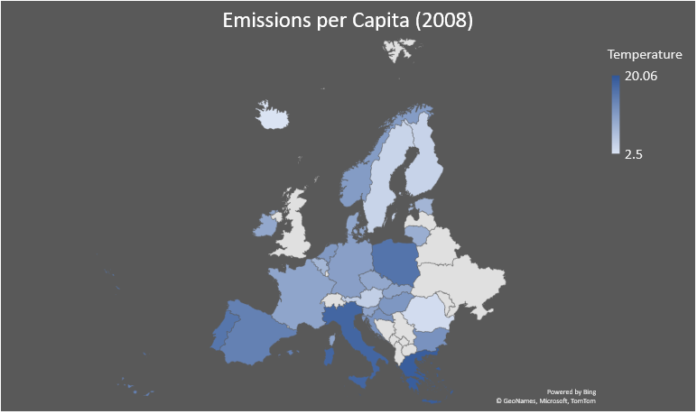
Air Quality
Temperature
Fires
Emissions per Capita
2008

Slide 5
